Slide 1
Expressions

Slide 2
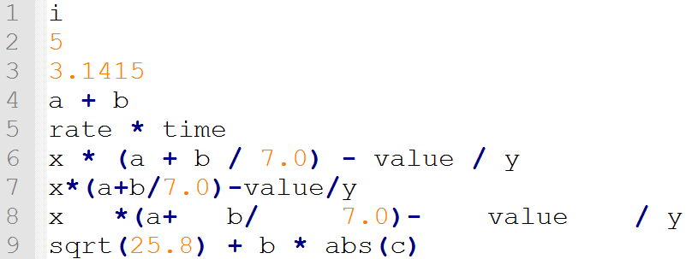
Expressions
Used to calculate some value
Consists of at least one operand and one or more operators
No limit to how complex they can be

Slide 3
Operands (Values)
Variables: values represented by identifiers that can be changed
Constants (e, PI): values represented by identifiers that cannot be changed
Literals (5, ‘A’, “hello world”): a value not represented by an identifier

Slide 4
Operators (Symbols)
Comparison (<, >, ==, !=): Compare values (e.g. greater than, not equal to)
Arithmetic (+, -, *): Calculate values (e.g. add, subtract, divide)
Logical (&&, ||, !): Combine operators (e.g. greater than 8 and less than 10)
Assignment (=, +=, -=): Changes the value of the left operand

Slide 5
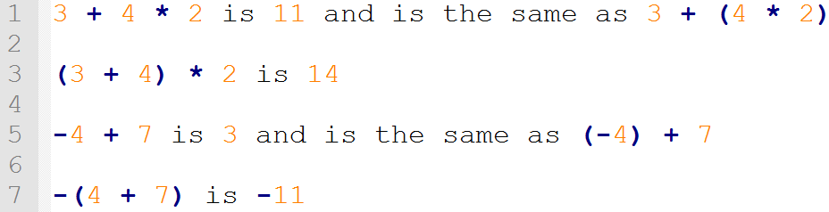
Precedence
All operators have a certain precedence
If there’s more than one operator, expression will evaluate based on precedence
But what if two operators have the same precedence?

Slide 6
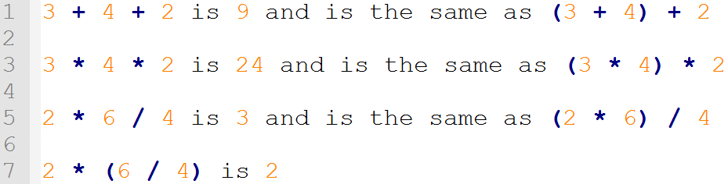
Associativity
Determines the order of evaluation if there’s two or more operators of the same precedence
Either left-to-right (L-R) or right-to-left (R-L)

Slide 7
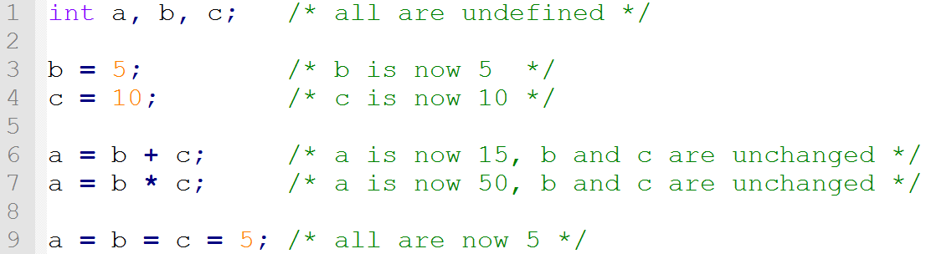
Assignment Operators
There are two types of assignments: simple and compound
The ‘=‘ operator is assignment, not equality (which is ‘==‘)
The operator sets the value on the left to the value on the right

Slide 8
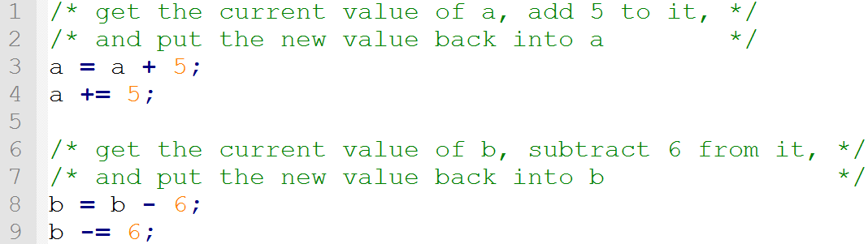
Compound Assignment
Can add, subtract, divide, etc. a value from a variable and then assign the new value back to the variable
We can do this more succinctly using compound assignment

Slide 9
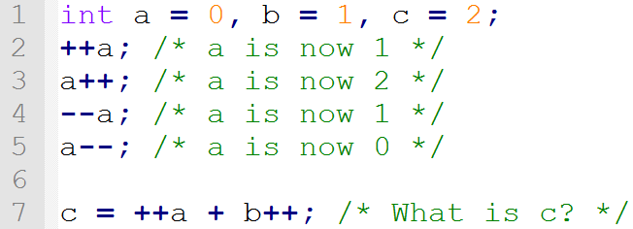
Increment/Decrement
Adding or subtracting one from a variable is very common
There are special operators for this: increment and decrement operators
There are two versions of each operator: prefix and postfix
Prefix is performed before the rest of the expression, Postfix is after

Slide 10
Comparison Operators
Relational Operators:
< Less than
> Greater than
<= Less than or equal to
>= Greater than or equal to
Equality Operators:
== Equal to
!= Not equal to

Slide 11
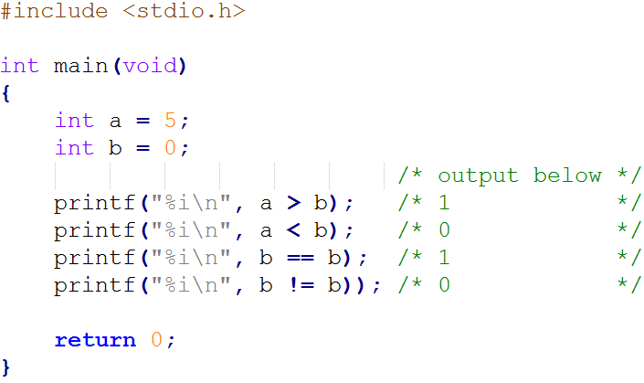
Comparison Cont.

Slide 12
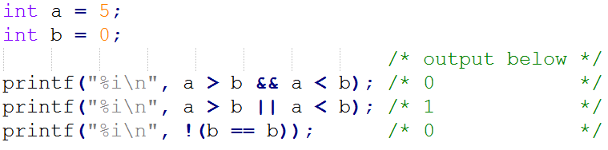
Logical Operators
Making more than one comparison in an expression
&& Logical AND (true if this AND that are true)
|| Logical OR (true if this OR that is true)
Negating an expression
! Logical NOT (Swaps true and false)

Slide 13
Binary vs Unary Operators
Binary
Unary
A + B
A – B
A > B
A < B
A == B
A += B
A -= B
!A
-A
sizeof(A)
++A
--A
A++
A--
The expressions in green evaluate to a value, but do not change the operand(s)
The expressions in red, however, do change their operand(s)

Slide 14
Summary
Expressions are used to calculate some value
The involve at least one operand and one or more operators
Operators are evaluated based on precedence and associativity
The assignment operator ‘=‘ is different from the equality operator ‘==‘
Certain operators change their operands

Slide 15
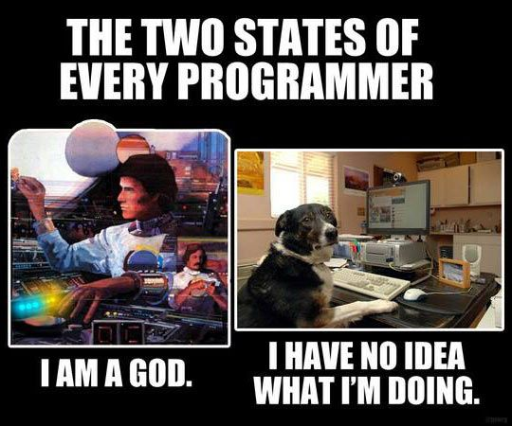
Questions?

